Slide 1
How to use git
Jimmy Xu
Notes:
GIT最初是由Linus Benedict Torvalds为了更有效地管理Linux内核开发而创立的分布式版本控制软件

Slide 2
Feature of Git
Distributed version management
Powerful branch management (pointer，local branch)
Division of work
Steep learning curve
Notes:
Linus
分布式版本管理
强大的分支管理 （使用指针，本地分支）
分工协作（无需经过中央服务器）
学习曲线陡峭

Slide 3
Topic
Demo
  【On 26.6】
    Create remote repository on 26.6 for Pugna
  【On 26.9】
    Clone repository from 26.6(redmine) to 26.9(hotfix)
    Add Pugna source code ，commit to master branch
    Create develop branch from master branch
    Push all to remote repository(26.6)

Slide 4
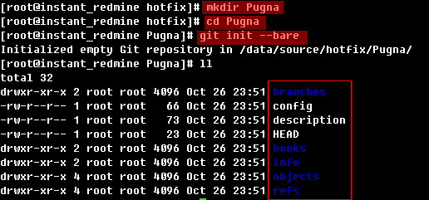
Init Remote Repository(211.98.26.6)
Create remote git repository
$ git init --bare (for sharing)
  only contain history committed version(wihtout work tree)
  user can not do git operation
Notes:
使用”git init –bare”方法创建一个所谓的裸仓库，之所以叫裸仓库是因为这个仓库只保存git历史提交的版本信息，而不允许用户在上面进行各种git操作，如果你硬要操作的话，只会得到下面的错误（”This operation must be run in a work tree”）

Slide 5
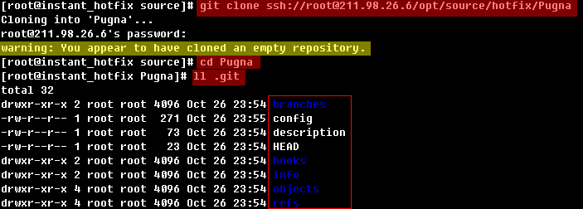
Init Local Repository(211.98.26.9) (1)
Clone from 211.98.26.6
$ git clone ssh://root@211.98.26.6/opt/source/hotfix/Pugna
Set repository options (save to .git/config)
$ git config user.name "Jimmy Xu"
$ git config user.email "jimmy.xu@madeiracloud.com"
$ git config remote.origin.url ssh://root@211.98.26.6/opt/source/hotfix/Pugna
$ git config remote.origin.fetch +refs/heads/*:refs/remotes/origin/*
$ git config branch.master.remote origin
$ git config branch.master.merge refs/heads/master
$ git config core.autocrlf input
Notes:
【如果没有配置user.name】
[root@instant_hotfix Pugna]# git commit -m "init import"
*** Please tell me who you are.

Slide 6
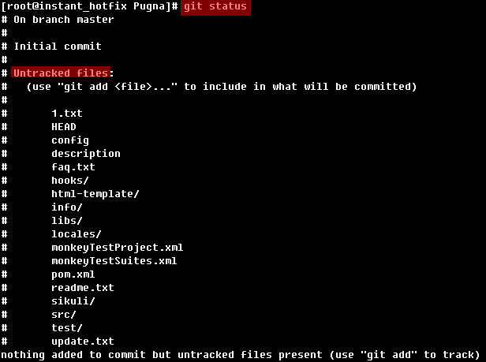
Init Local Repository(211.98.26.9)(2)
Add source code to work tree
$ shopt -s dotglob
$ mv Pugna_bak/* Pugna
View file status
Notes:
shopt -s dotglob 用于mv时，包括隐藏文件

Slide 7
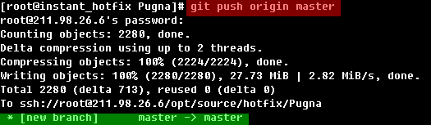
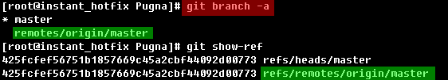

Init Local Repository(211.98.26.9)(4)
Push to remote repository(26.6)
$ git push origin master
View local branch
View remote branch(run on 26.6)

Slide 8
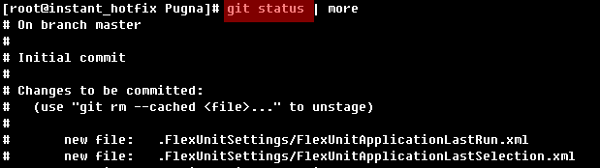


Init Local Repository(211.98.26.9)(3)
Add file to index(staging area)
$ git add . #process new and modified file,but withtout deleted files
Commit to repository
$ git commit -m “init import”
View branches
$ git branch –a
$ git show-ref
Notes:
使用”git init –bare”方法创建一个所谓的裸仓库，之所以叫裸仓库是因为这个仓库只保存git历史提交的版本信息，而不允许用户在上面进行各种git操作，如果你硬要操作的话，只会得到下面的错误（”This operation must be run in a work tree”）
$ git add -A #process new ,modified and deleted files
$ git add . #process new and modified file,but withtout deleted files
$ git add -u #process modified and deleted file, but without new files

Slide 9
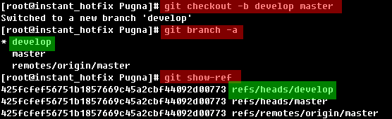
Create develop branch(211.98.26.9)
Create develop branch then switch to develop branch
$ git branch develop
$ git checkout develop
or
$ git checkout -b develop master

Slide 10

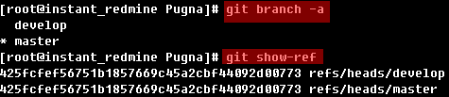
Push develop branch to remote repository
push develop branch to remote repository(26.6)
$ git push --all
View remote branch(run on 26.6)

Slide 11
THANKS!

Slide 12
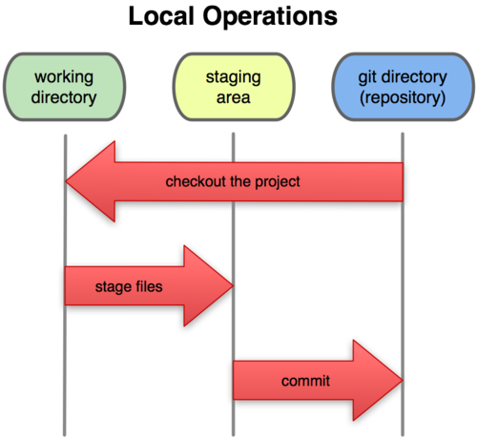

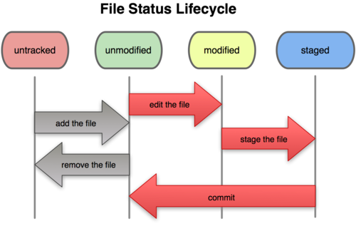
File status
Notes:
git 的 add 自命令，除了对尚未版本控制的文件进行添加外，还对工作区的修改文件进行操作。
git status 检查文件状态

Slide 13


Code State transition diagram
.git/index
staging
work tree
add
commit
.git(repository)
modify
untracked
staged
modify
new code
pull
push
center repo

Slide 14
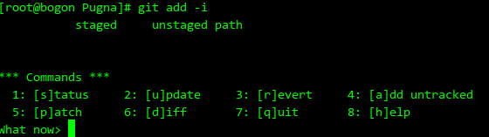
Git add
Non-interactive mode
$ git add -A #process new ,modified and deleted files
$ git add . #process new and modified file,but withtout deleted files
$ git add -u #process modified and deleted file, but without new files
Interactive mode
$ git add -i

Slide 15
About clone
Clone bare repository from remote
$ git clone --bare ssh://root@211.98.26.6/opt/source/hotfix/Pugna
#create Pugna.git dir
Clone bare repository from local
$ git clone --bare -l Pugna
#create Pugna.git dir
Clone full repository from remote
$ git clone ssh://root@211.98.26.6/opt/source/hotfix/Pugna
#create Pugna dir with .git
Clone full repository from local
$ git clone -l Pugna
#create Pugna dir with .git

Slide 16


Git config
Config file type
$git config --system user.name "Jimmy Xu“ #Write to /etc/gitconfig
$git config --global user.name "Jimmy Xu“ #Write to $HOME/.gitconfig
$git config user.name "Jimmy Xu“ #Write to .git/config
Config parameter list(press tab twice)
Config parameter usage
$git help config
$man git-config
Set parameter
$git config user.name "Jimmy Xu"
$git config user.email "jimmy.xu@madeiracloud.com"
$git config remote.origin.url ssh://root@211.98.26.6/opt/source/hotfix/Pugna
$git config core.autocrlf true
Show current parameter
Notes:
git config user.name "Jimmy Xu"
git config user.email "jimmy.xu@madeiracloud.com"
git config remote.origin.url ssh://root@211.98.26.6/opt/source/hotfix/Pugna
git config remote.origin.fetch +refs/heads/*:refs/remotes/origin/*
git config branch.master.remote origin
git config branch.master.merge refs/heads/master
git config core.autocrlf input # for linux
git config core.autocrlf true # for windows
git config --list

Slide 17
branch operation
View local branch $ git branch
View remote branch $ git branch -r
Create locale branch $ git branch [name] ----it wouldn’t switch to the new branch
Switch branch $ git checkout [name]
Create&switch to new branch $ git checkout -b [name]
Delete branch $ git branch -d [name] ---- -d option only delete merge branch -D force delete branch
Merge branch $ git merge [name] ----merge branch [name] to current branch
Create remote branch $ git push origin [name] ----push local branch to remote
Delete remote branch $ git push origin :heads/[name]
or $ gitpush origin :[name]

Slide 19
git command list(All)
git-add | git-diff-tree | git-merge-index | git-rev-list
git-am | git-fast-export | git-merge-one-file | git-rev-parse
git-annotate | git-fast-import | git-mergetool | git-rm
git-apply | git-fetch | git-merge-tree | git-send-email
git-archimport | git-fetch-pack | git-mktag | git-send-pack
git-archive | git-filter-branch | git-mktree | git-shell
git-bisect | git-fmt-merge-msg | git-mv | git-shortlog
git-blame | git-for-each-ref | git-name-rev | git-show
git-branch | git-format-patch | git-notes | git-show-branch
git-bundle | git-fsck | git-pack-objects | git-show-index
git-cat-file | git-gc | git-pack-redundant | git-show-ref
git-check-attr | git-get-tar-commit-id | git-pack-refs | git-sh-setup
git-checkout | git-grep | git-parse-remote | git-stash
git-checkout-index | git-gui | git-patch-id | git-status
git-check-ref-format | git-hash-object | git-peek-remote | git-stripspace
git-cherry | git-help | git-prune | git-submodule
git-cherry-pick | git-http-backend | git-prune-packed | git-svn
git-citool | git-http-fetch | git-pull | git-symbolic-ref
git-clean | git-http-push | git-push | git-tag
git-clone | git-imap-send | git-quiltimport | git-tar-tree
git-commit | git-index-pack | git-read-tree | git-unpack-file
git-commit-tree | git-init | git-rebase | git-unpack-objects
git-config | git-instaweb | git-receive-pack | git-update-index
git-count-objects | git-log | git-reflog | git-update-ref
git-cvsexportcommit | git-lost-found | git-relink | git-update-server-info
git-cvsimport | git-ls-files | git-remote | git-upload-archive
git-cvsserver | git-ls-remote | git-repack | git-upload-pack
git-daemon | git-ls-tree | git-replace | git-var
git-describe | git-mailinfo | git-repo-config | git-verify-pack
git-diff | git-mailsplit | git-request-pull | git-verify-tag
git-diff-files | git-merge | git-rerere | git-whatchanged
git-diff-index | git-merge-base | git-reset | git-write-tree
git-difftool | git-merge-file | git-revert

Slide 20



Some tools
 | msysgit Git for Windows
http://code.google.com/p/msysgit/
 | tortoisegit Porting TortoiseSVN to TortoiseGit
http://code.google.com/p/tortoisegit/
 | GITLAB Self Hosted Git Management
http://gitlabhq.com/

Slide 21
GUI Tools
git gui
  yum install git-gui
Gitk
  yum install gitk
EGit (Eclipse plugins)
TortoiseGit（for windows， require msysgit）

Slide 22
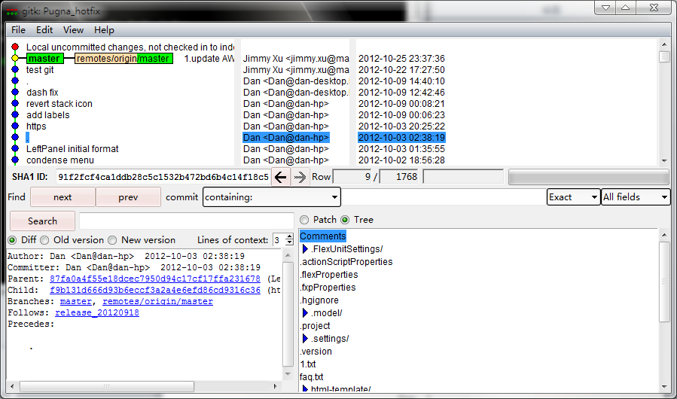
Gitk

Slide 23
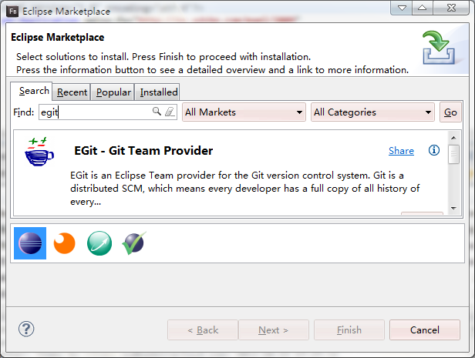
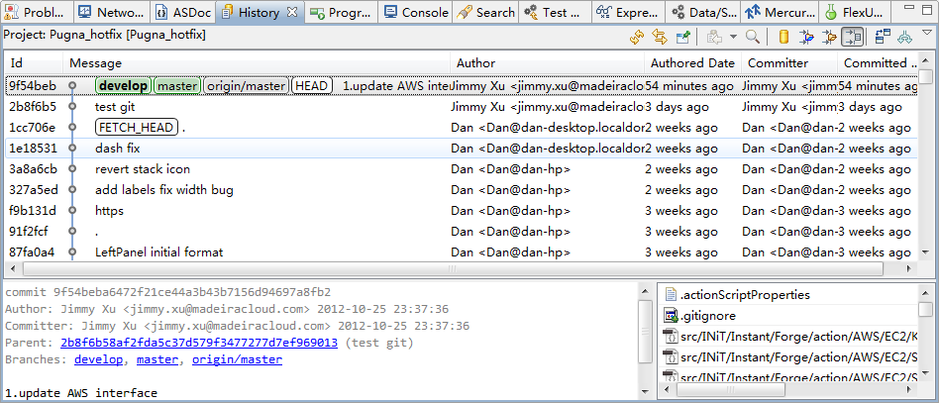
EGit – Eclipse Plugins

Slide 24



Difference between git merge and rebase
merge
$ git pull
rebaes
$ git pull --rebase

Slide 25
View log of branch
View local branch
$ git log develop
View remote branch(same)
$ git log origin/develop
$ git log remotes/origin/develop
$ git log refs/origin/develop

Slide 26
Git autocomplete in bash
Config for CentOS6
[root@bogon ~]# locate git-completion
/usr/share/doc/git-1.7.1/contrib/completion/git-completion.bash
[root@bogon ~]# cp /usr/share/doc/git-1.7.1/contrib/completion/git-completion.bash ~/.git-completion
[root@bogon ~]# vim ~/.bashrc
#Add following line to ~/.bashrc
source ~/.git-completion
Config for CentOS5
[root@bogon ~]# vim ~/.bashrc
#Add following line to ~/.bashrc
source /etc/bash_completion.d/git
Usage
[root@bogon ~]# git #(press tab twice)
add fetch rebase
…
diff pull tag
Notes:
[cent os 6]
[root@bogon ~]# locate git-completion
locate: can not stat () `/var/lib/mlocate/mlocate.db': No such file or directory
[root@bogon ~]# updatedb

Slide 27
remote repo operation
Clone remote repo $ git clone ssh://root@211.98.26.6/opt/source/hotfix/Pugna
View remote repo $ git remote -v
Add remote repo $ git remote add [name] [url]
Remove remote repo $ git remote rm [name]
Modify remote repo $ git remote set-url --push [name] [newUrl]
Pull from remote repo $ git pull [remoteName] [localBranchName]
Push to remote repo $ git push [remoteName] [localBranchName]

Slide 28
HEAD
Pointer to current branch
$ git show HEAD # the tip of the current branch
$ git show HEAD^ # to see the parent of HEAD
$ git show HEAD^^ # to see the grandparent of HEAD
$ git show HEAD~4 # to see the great-great grandparent of HEAD

Slide 29
.gitignore file
[root@bogon ~]# vi .gitignore
#Add the following lines
bin-debug/*
*.orig

Slide 30
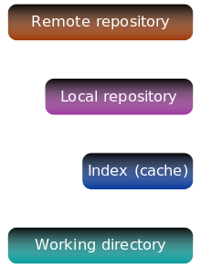
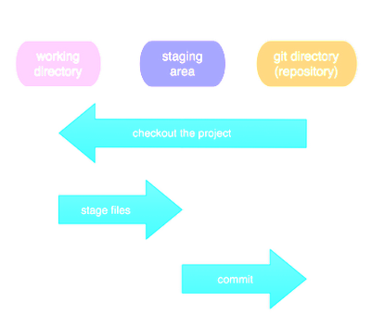

Slide 31
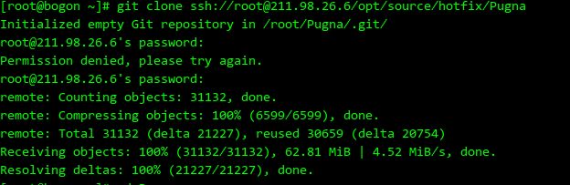
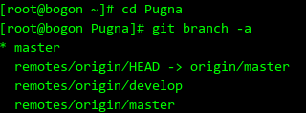
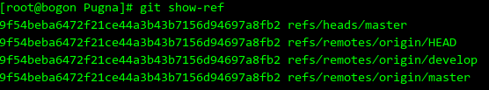
1 Get project copy
Clone project
Show all branch
Show all heads in repo
Notes:
git clone ssh://root@211.98.26.6/opt/source/hotfix/Pugna

Slide 32
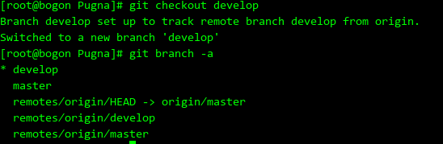
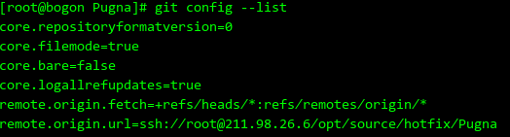
2 Switch branch
Switch branch
211.98.26.6

